Slide 1

Depository Services
(Available to demat account holder)

Slide 2

Disclaimer
Information contained in this presentation is as on September 30, 2022.
The information contained in this presentation is only for Educational and Awareness Purposes related to securities market .
This presentation is only for Educational and Investor Awareness Programs and shall not be used for any legal interpretations.
SEBI or Stock Exchanges or Depositories shall not be responsible for any damage or loss to any one of any manner from use of this material.
Suggestions or feedbacks, if any, may please be sent by mail to visitsebi@sebi.gov.in.
2

Slide 3
Flow of Presentation
Dematerialisation of Securities
Transposition of Securities
Rematerialisation of Securities
Transmission of Securities
3

Slide 4
Dematerialisation
4

Slide 5
What is Dematerialisation?
Conversion of physical securities into electronic form.
Some examples of securities that can be Dematerialised :
Equity Shares
Preference Shares
Debentures
Bonds
Mutual Fund Units
Government Securities
Sovereign Gold Bonds
5

Slide 6
Dematerialisation : Prerequisites
Investor should have a Demat account with any Depository Participant (DP)
Securities should be available for Dematerialisation (active ISIN):
Company Details whose securities are available for Demat is available on websites of Depositories
  - CDSL : https://www.cdslindia.com/Investors/InvestorCorner.aspx
  - NSDL : https://nsdl.co.in/master_search.php
Details of Registrar and Transfer Agent (RTA) of company available on “Investor Relations” section of the Company website
6

Slide 7
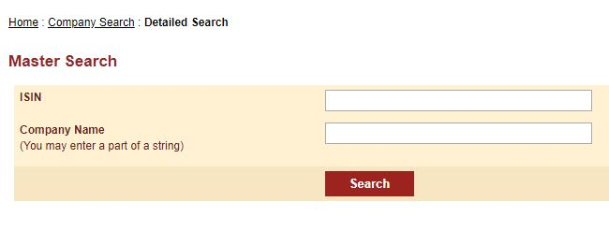
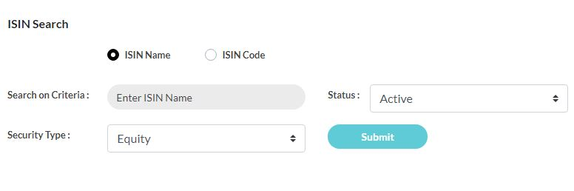
Dematerialisation : Check Company Status (Sample)
Checking company status on NSDL website
Checking company status on CDSL website
7

Slide 8
Dematerialisation : Process
Broad Process :
Care to be taken :
  DRF should be signed by all holders (in case of multiple holders)
  Pattern of holdings in the certificates should match with Demat account
Separate DRF should be submitted for -
  Each ISIN (meaning of ISIN in later slide)
  Free and locked in securities
  Securities locked-in for different reasons and different lock-in release dates
Obtain Demat Request Form (DRF) from DP
Fill DRF properly and sign
Submit DRF and physical certificates to DP
8

Slide 9
Dematerialisation : Meaning of ISIN
Example of ISIN - IN E 005A 08 02 0
International Securities Identification Number (ISIN)
Unique Identification Number for Each Security
Contains 12 Characters
Allotted by NSDL in India for all securities except Government securities
Same ISIN used by both depositories
Check Digit
‘IN’ stands for India
‘E’ stands for Company.
‘F’ stands for Mutual Funds
‘08’ for Security Code
Serial No./ Type of Instrument.
‘005A’ for Company Identity
9

Slide 10
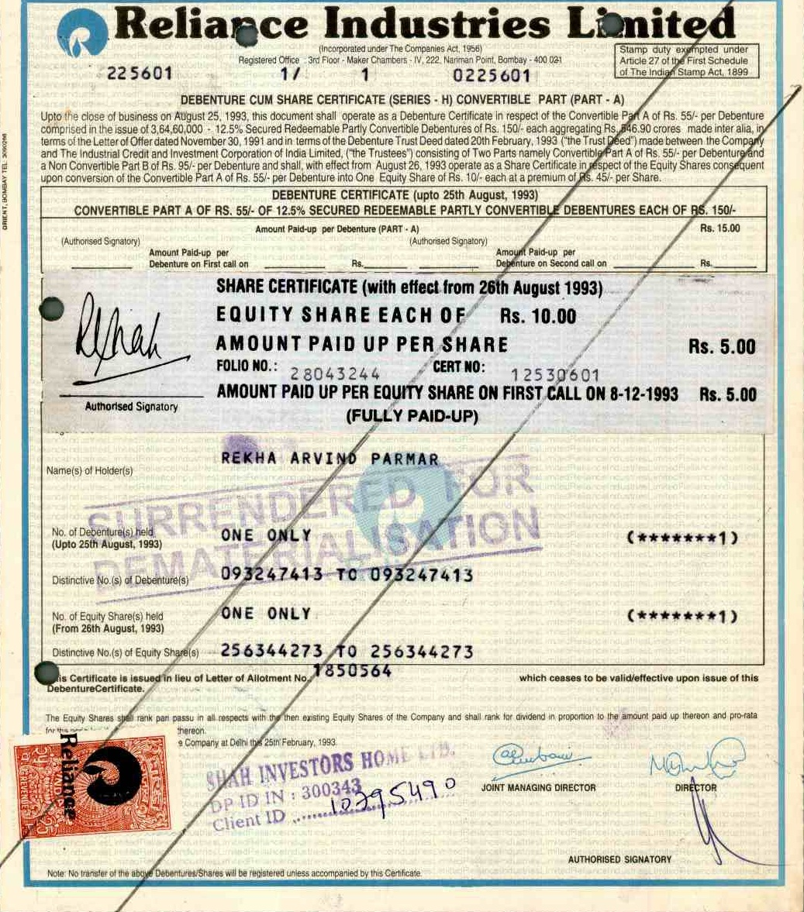
Dematerialisation : Sample Physical Security
Stamp of Company
Stamp of DP with DP ID and Client ID details
10

Slide 11
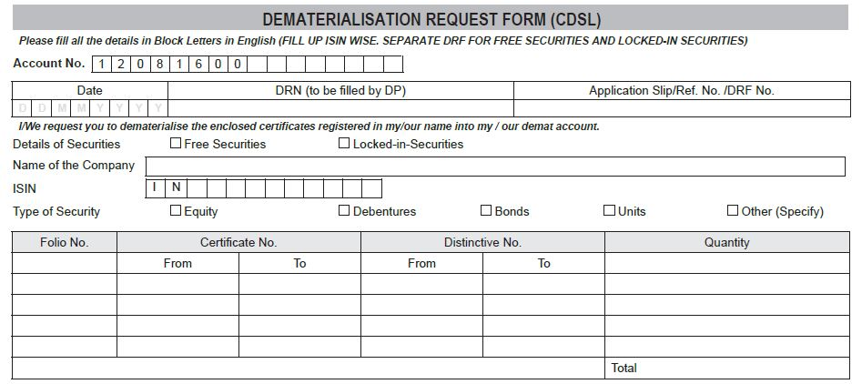
Dematerialisation : Sample Demat Request Form (Equity shares)
Put Folio Number
Refer Physical Certificate for Certificate Nos and Distinctive Nos.
Put Numjber of Securities and Total
11

Slide 12
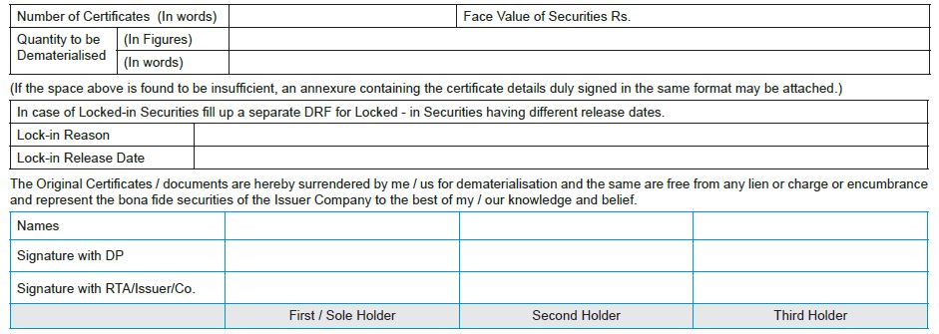
Dematerialisation : Sample Demat Request Form (Equity shares)
Signatures provided in boxes for “Signature with DP” and “Signature with RTA / Issuer / Company” should exactly match with signatures provided to DP and RTA / Issuer / Company earlier.
12

Slide 13
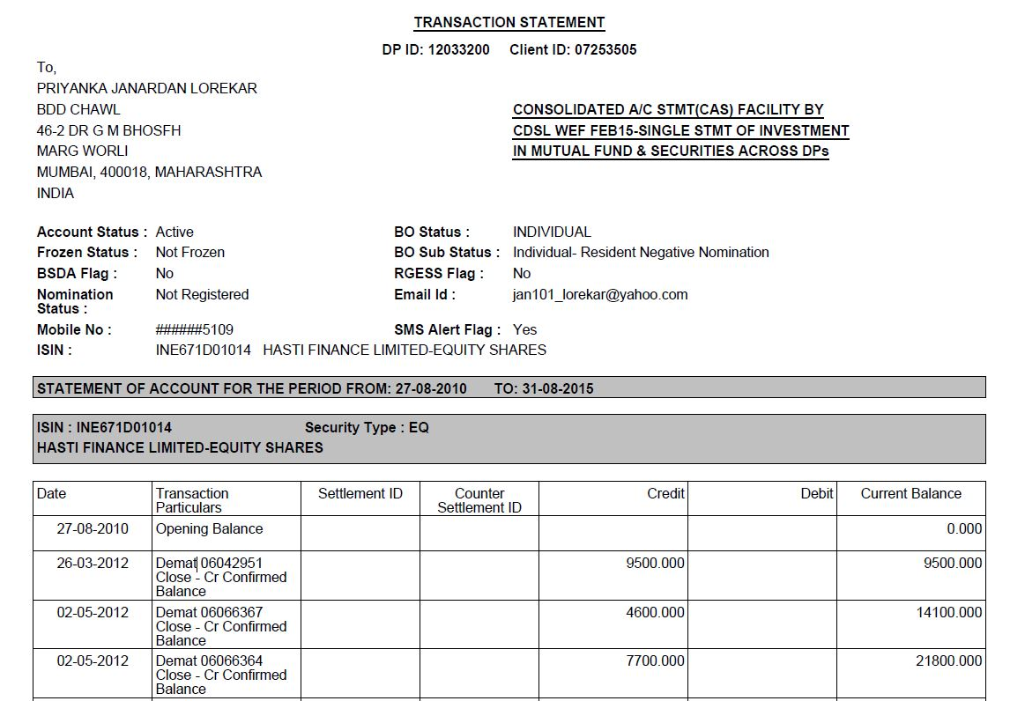
Dematerialisation : Sample Transaction Statement showing Credit of Dematerialised Shares
Unique ID of DP in the system of the depository
Unique ID of investor in the system of the depository
Name & Address of investor
Regd Email ID of investor
Regd Mobile No. of investor
13

Slide 14
Dematerialisation : Mutual Fund Units
Following Mutual Funds have the option to convert/ subscribe to Demat Form:
All existing mutual fund units issued by all the mutual fund companies.
All New Fund Offers (NFOs).
All existing mutual fund investments through SIP mode
ISIN of your mutual fund units –
Can be seen in the Statement of Account / Consolidated Account Statement (CAS)
Can be searched at website of CDSL/NSDL.
Investor needs to submit a ‘Conversion Request Form’ along with Self Attested Statement of Account received from Mutual Fund to the Depository Participant (DP).
14

Slide 15
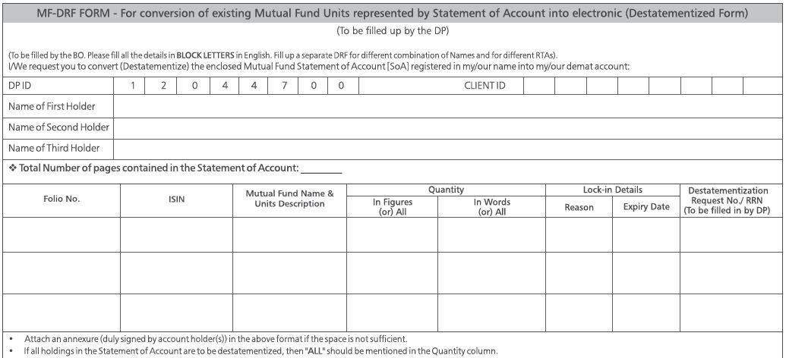
Dematerialisation : Sample Demat Request Form (Mutual Fund Units)
15

Slide 16
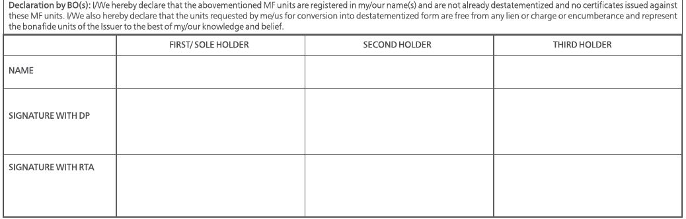
Dematerialisation : Sample Demat Request Form (Mutual Fund Units)
Signatures provided in boxes for “Signature with DP” and “Signature with RTA” should exactly match with signatures provided to DP and RTA earlier.
16

Slide 17
Dematerialisation : Rejection of Demat Request Form (DRF)
Some common reasons for rejection of DRF :
Incorrect Holder(s) name
Certificate details mismatch
Demat request initiated under wrong ISIN
Transmission Form / Death Certificate not submitted
DRF not signed / stamped by DP
Signature mismatch
Verification of Share Certificate(s) not received from RTA within prescribed timelines
Mismatch between actual quantity of shares and quantity of shares mentioned in DRF
Shares under “stop transfer” / court injunction
Certificates submittedAllotment / Call Payment receipt not attached
are “reported as stole”
Duplicate certificates already issued
Old defunct certificates surrendered for Demat
Forfeited securities surrendered for Demat
Forged endorsement on certificate
17

Slide 18
Dematerialisation : What to do if Demat Request is rejected ?
Steps to be taken after rejection of DRF :
DP informs investor about rejection of Demat request.
Investor can see transaction status in statement of transactions.
Issuer / RTA sends an Objection Memo containing reasons of rejection of request
Investor needs to rectify the errors / remove deficiency in the documentation
Finally, Submit the request for Demat once again through DP.
18

Slide 19
Transposition
19

Slide 20
Transposition Form
When Transposition Form needs to be submitted?:
  For rectification of order of names of Joint Demat Account holders.
  When order of names of joint shareholders on the physical share certificate is not same as the order of names on Joint-Demat account.
  Transposition form will have to be signed in the same order as on the Joint Demat account.
20

Slide 21
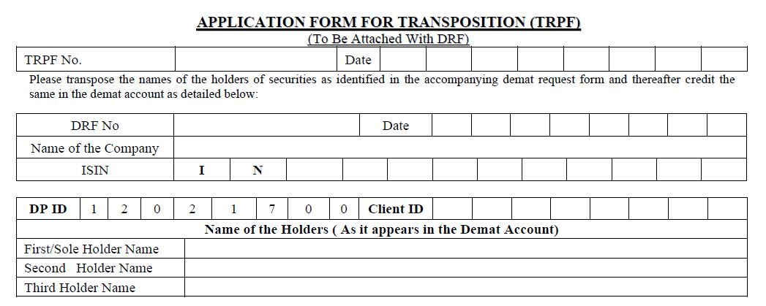
Transposition : Sample Application Form for Transposition (TRPF) (1/3)
Client ID of Joint Demat Account
Ref to Demat Request Form
Names of investors and order of names must be exactly matching with that in Demat Account
21

Slide 22
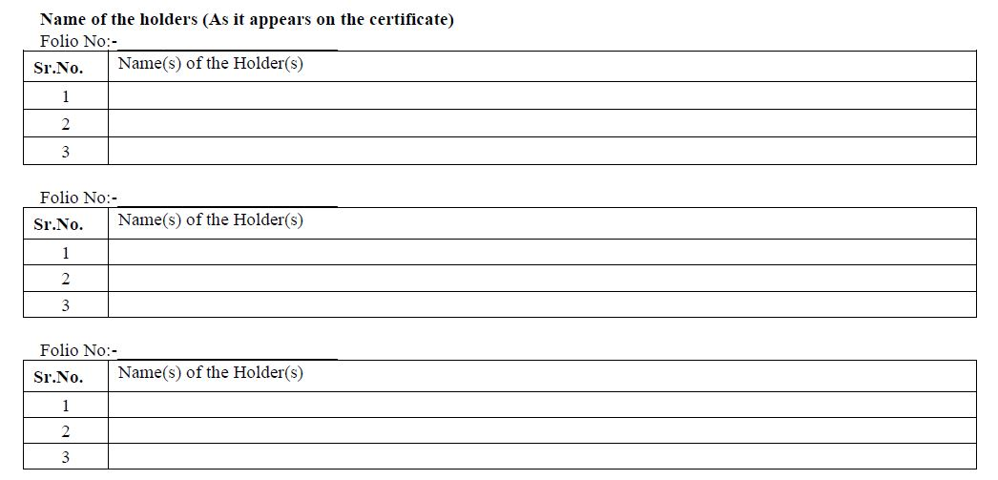
Transposition : Sample Application Form for Transposition (TRPF) (2/3)
22

Slide 23
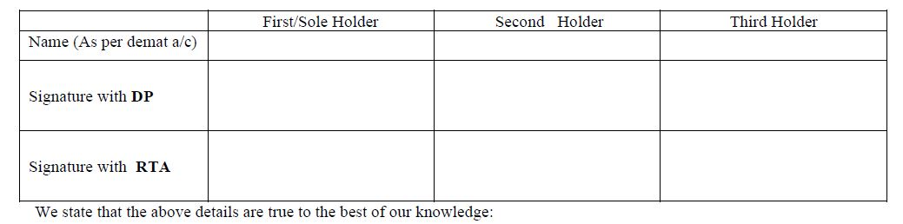
Transposition : Sample Application Form for Transposition (TRPF) (3/3)
Signatures provided in boxes for “Signature with DP” and “Signature with RTA” should exactly match with signatures provided to DP and RTA earlier.
23

Slide 24
Rematerialisation
24

Slide 25
Rematerialisation
What is Rematerialisation?
Conversion of securities held in Demat form to physical form
Process
Pre-requisite of Rematerialisation
Sufficient Balance of Securities in Demat Account.
Submit Remat Request Form (RRF) to DP
RRF should be signed by all holders (for multiple holders)
Separate RRF should be submitted for -
  Each ISIN
  Free and locked in securities
  Securities locked-in for different reasons and different release dates
25

Slide 26
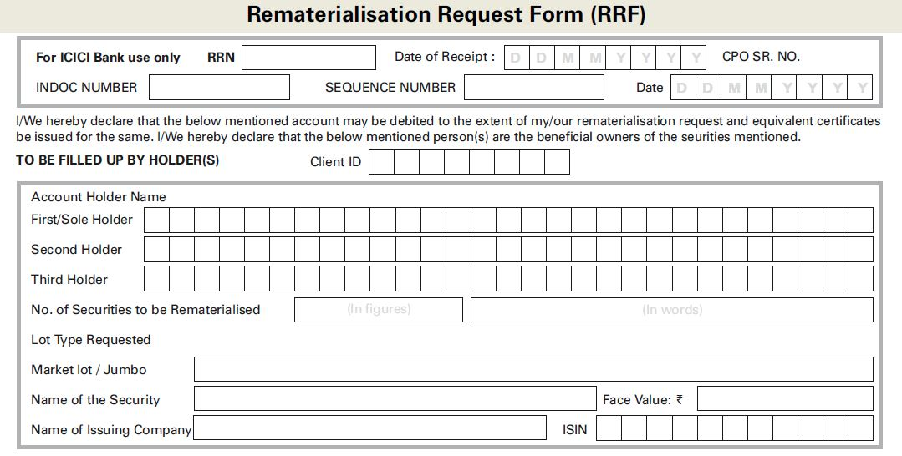
Rematerialisation : Sample Remat Request Form
To be filled by the DP
26

Slide 27
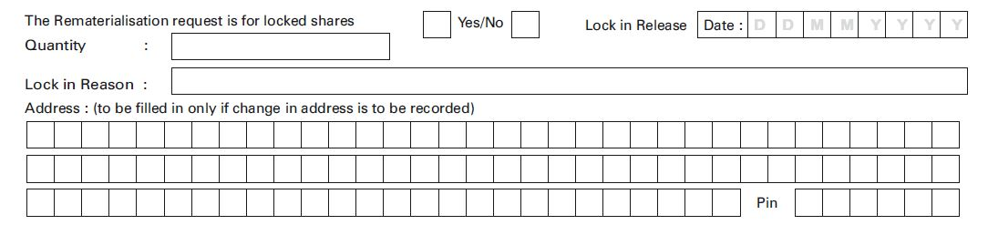
Rematerialisation : Sample Remat Request Form (Lock-in)
27

Slide 28
Rematerialisation : Rejection of Remat Request Form (RRF)
Incomplete or incorrect RRF
RRF details mismatch with electronic request
Non receipt of RRF by Issuer / RTA
Investor may make corrections and Re-Submit the RRF
28

Slide 29
Transmission
29

Slide 30
What is Transmission?
Meaning :
Securities owned by a person who has died are “transmitted” to his legal heirs.
Legal heirs need to submit necessary documents:
Notarized death certificate
Notarized Succession certificate
Notarized copy of the Probate or Letter of Administration, etc.
Transfer brought about - By operation of law.
Investor to get two options regarding nomination
  To provide nomination in the prescribed form up to three person along with their percentage
  Opting out of nomination through prescribed declaration form
Folios/Account to be freezed if none is opted till March 31, 2023
30

Slide 31
Transmission Procedure
Steps for Transmission
Surviving joint holder/s, nominee or legal heirs of deceased account holder to approach the Depository Participant (DP)
For shares held in physical form - Approach each Company and their respective RTAs.
31

Slide 32
Transmission : Documents to be submitted (for Individual accounts) (1/3)
Account Holder | Documents Required
Surviving Holder (s) in a Joint Account | Copy of Death Certificate duly attested by a Notary Public or by a Gazetted Officer.
Nominee of Deceased | Copy of Death Certificate duly attested by a Notary Public or by a Gazetted Officer. If Demat Account of claimant is not with DP of the deceased, copy of “Client Master Report” (CMR) of nominee’s account. (Nominee can obtain CMR from his DP)
32

Slide 33
Transmission : Documents to be submitted (for Individual accounts) (1/3)
Account Holder |  | Documents Required
Legal Heir (s)/ legal representative(s) [where deceased was a Sole Holder] | Value of Holding < Rs.15 lakh as on the date of application(If shares are in Demat) | Succession certificate Letter of Administration / Probate of the Will (as applicable) In absence of above documents: No objection certificate(s) with indemnity/ copy of Family Settlement Deed [as an alternate to No objection certificate(s)] Attested copy of Death Certificate Affidavit
 | Value of Holding > Rs.15 lakh as on the date of application(If shares are in Demat)* | Attested copy of Death Certificate Succession certificate Letter of Administration / Probate of the Will (as applicable)
In both the above mentioned situations, if Demat Account of claimant is not with DP of deceased, then a copy of Client Master Report of nominee’s account to be submitted.
Rs. 5 Lakhs if shares are in physical format
33

Slide 34
Transmission : Documents to be submitted (for Joint accounts) (3/3)
Death of a joint holder:
Surviving holders to open a new account with the Depository in the same sequence of surviving holders.
If surviving holders already have a Demat account but in different sequence, then Transposition process along with Transmission process must be followed.
Documents to be submitted:
  Duly filled Transmission Request Form (and Transposition Form, if applicable)
  Attested copy of Death Certificate
34

Slide 35
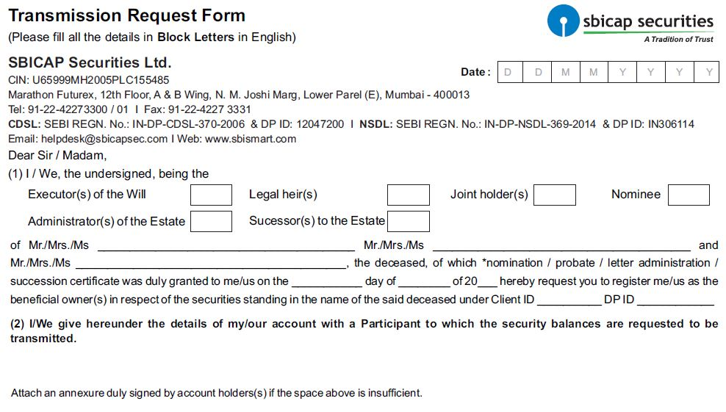
Transmission : Sample Transmission Request Form (1/2)
35

Slide 36
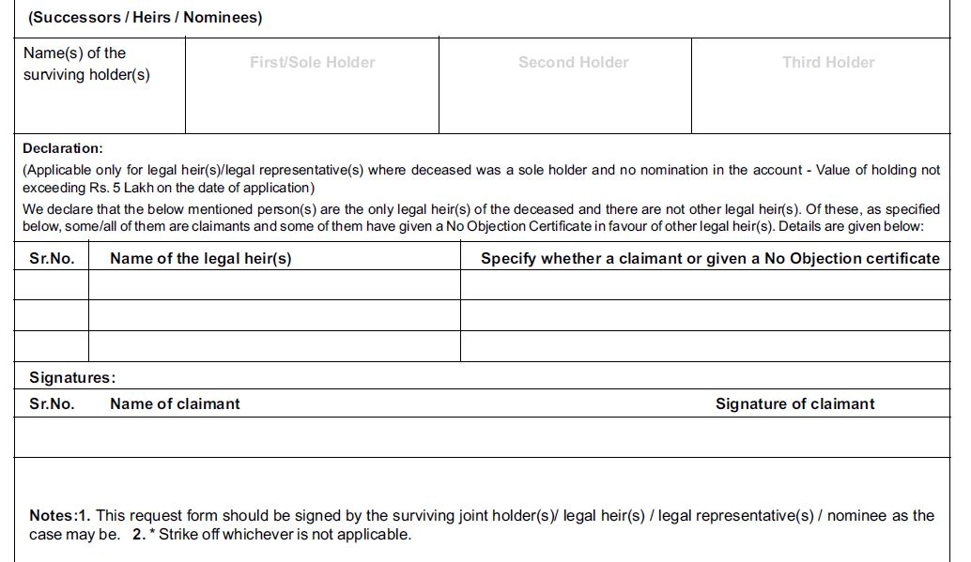
Transmission : Sample Transmission Request Form (2/2)
36

Slide 37
One Time Password (OTP) for off-market transfer and E-voting facility
Off-Market Transfer: Trades which are not settled through the Clearing Corporation/Clearing House of an exchange are classified as “Off Market Trades”.
To prevent fraudulent off-market transfer in demat account of client,
  One level client authentication introduced
  Client consent required through One Time Password (OTP)
  For Off-market transfer of shares in Demat account
E-Voting Facility: Enabled e-voting by way of single login
  Through client demat account
  Through website of depository and depository participants
  Confirmatory SMS to the shareholders by depository
37

Slide 38


Additional Information
For further information, you may visit the following web-sites and Mobile App:
  www.sebi.gov.in/
  https://investor.sebi.gov.in/
  Saa₹thi App
For Grievance Redressal, you may visit following website:
  www.scores.gov.in/
Or, you may call SEBI at following Toll-free Helpline Numbers from 9:00am to 6:00pm on all days (excluding declared holidays in the state of Maharashtra):
  1800 266 7575
  1800 22 7575
Helplines are available in 8 Languages:
English, Hindi, Bengali, Gujarati, Marathi, Kannada, Telugu and Tamil
SEBI : HAR INVESTOR KI TAAQAT
38

Slide 39
Thank You
39

